Slide 1
Event
Name, Institution

Slide 2
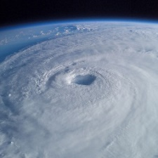
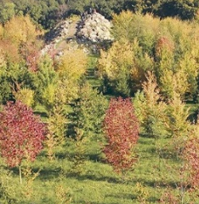
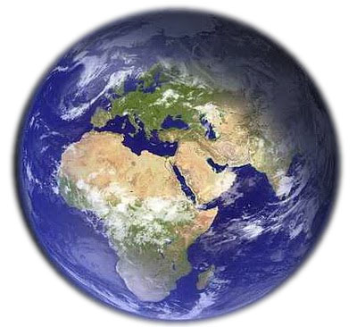
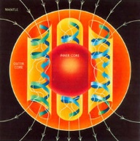

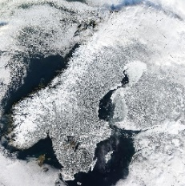
Earth System Sciences (ESS)
Geosphere, Atmosphere, Biosphere, Hydrosphere, Cryosphere, Anthroposphere and all their interactions
From Local Processes to Global Challenges
e.g. earth systems dynamics, natural hazards, climate change,
environmental pollution, water scarcity, land use change,
scarcity of raw materials
Observing, measuring, modelling,
analyzing, predicting the Earth System
In international and interdisciplinary settings
using spatio-temporal data as the common reference

Slide 3
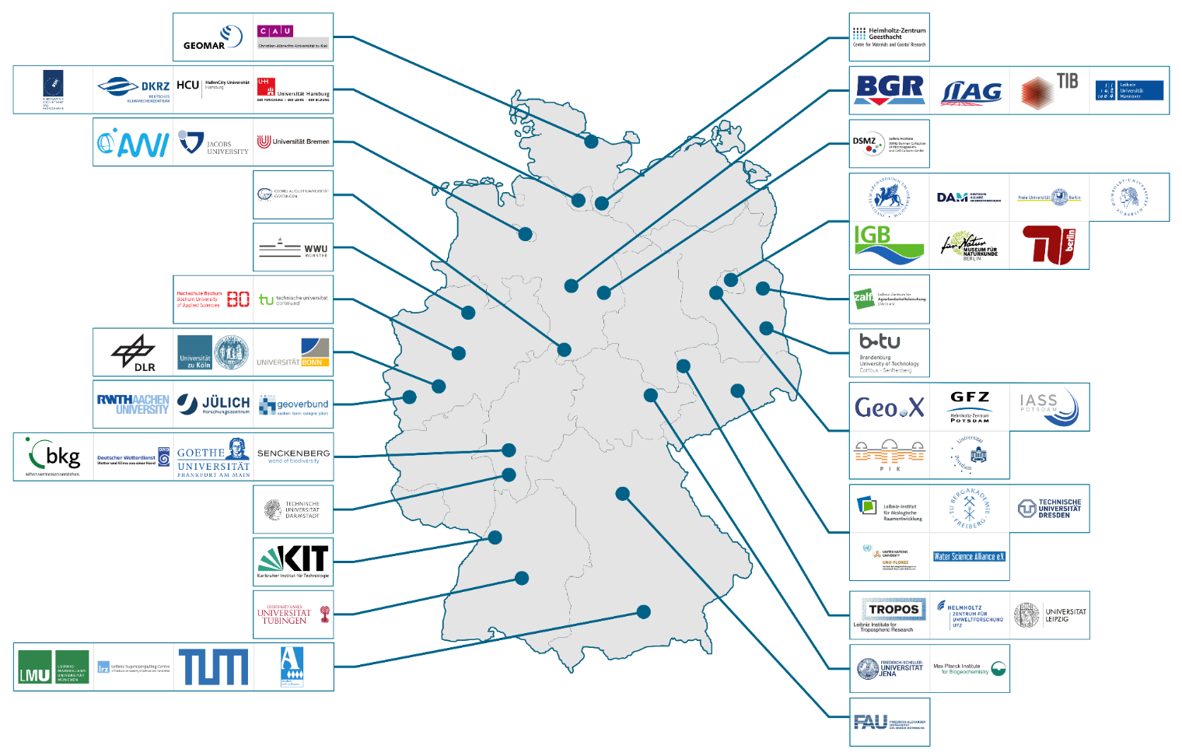
Who we are
58 institutions
covering the breadth of
Earth System Sciences (ESS)
  Universities
  Research Organizations
  Infrastructure Providers
  Governmental Institutions
  Scientific Associations
  & Networks
Established 2018 as
Open Consortium
and the ESS branch in the NFDI

Slide 4
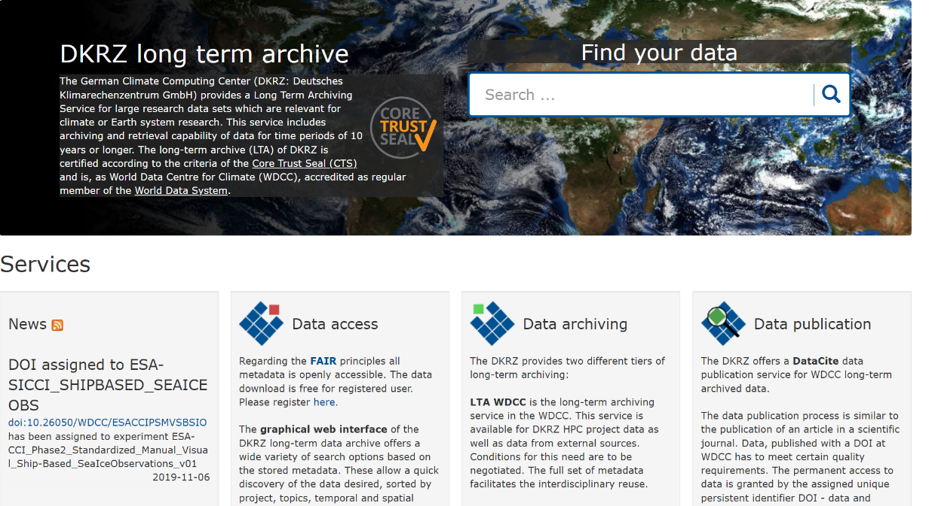
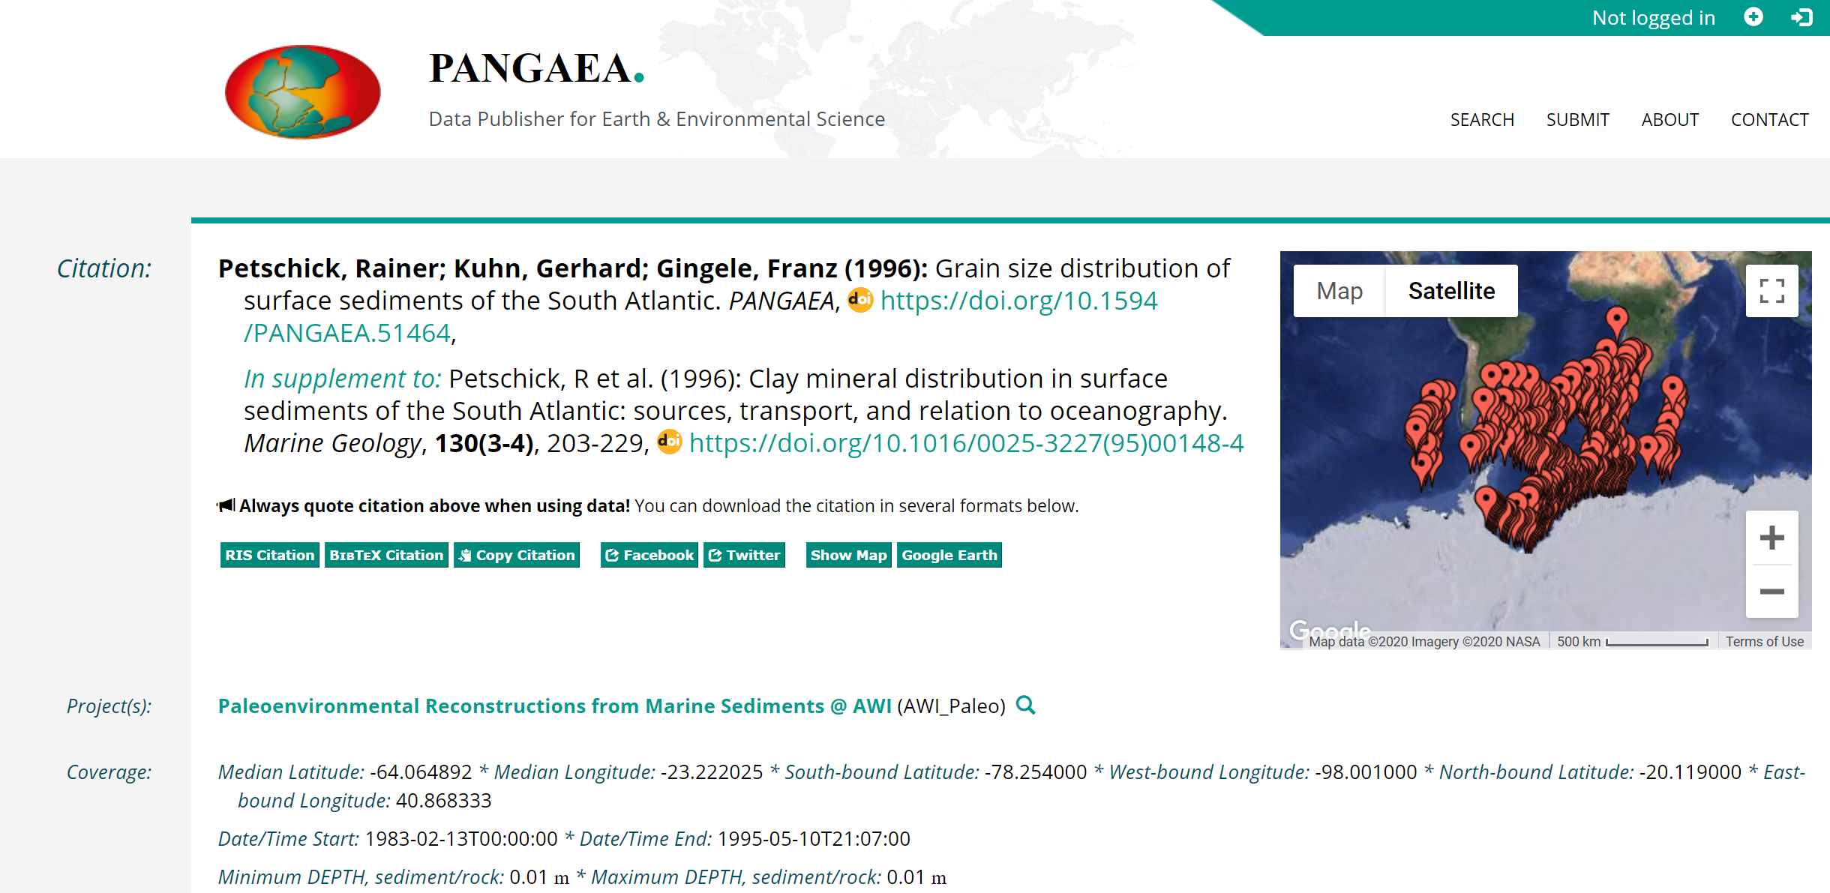
Where do we start in Earth System Sciences
Data from different sources,
growing openness
Often demanding models and
data intensive applications
Positive attitude to Openness, FAIR,
and Collaborative Development
Established data repositories
Several standards for interoperability
https://cera-www.dkrz.de/
https://doi.pangaea.de/10.1594/PANGAEA.51464

Slide 5
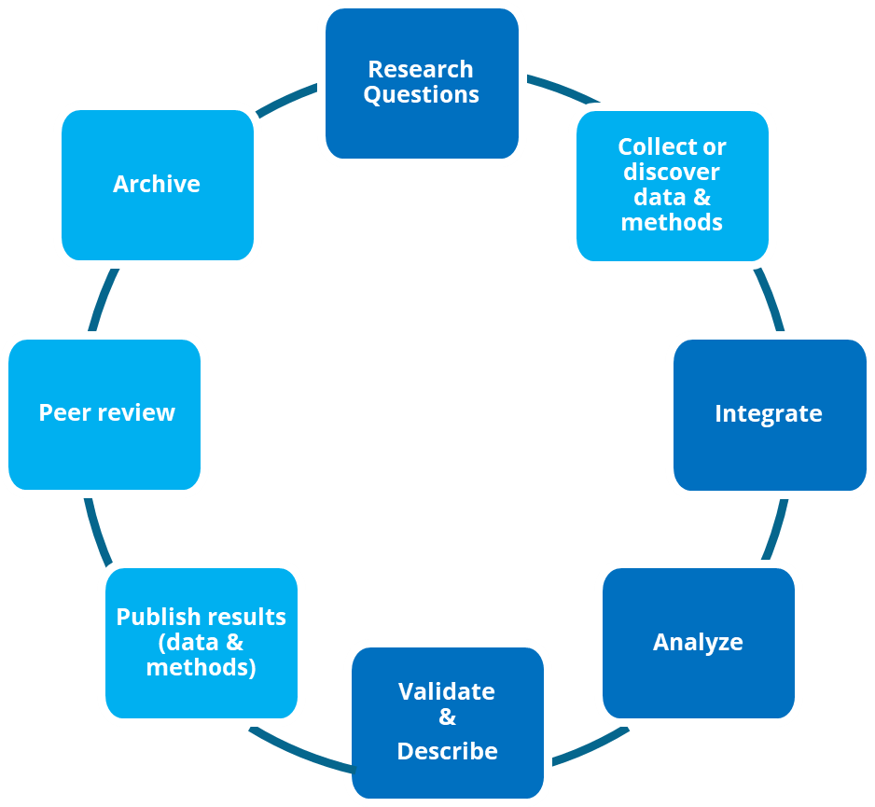
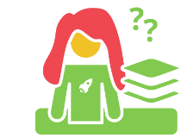
Our Issues
Large, diverse number of data services (>> 100)
and activities related to ESS…only a few sustainable
Data heterogeneity
quality, curation levels, licenses, semantics, sizes,
repeatability,scale, spatio-temporal resolutions,…
Different data cultures and velocities to FAIR
from data streams to long tail data; RDM experts and novices
Incomplete support along the data lifecycle
Lack of support (platforms, tools) for
joint and collaborative interpretation of heterogeneous and decentralized data
Research Data
Lifecycle

Slide 6
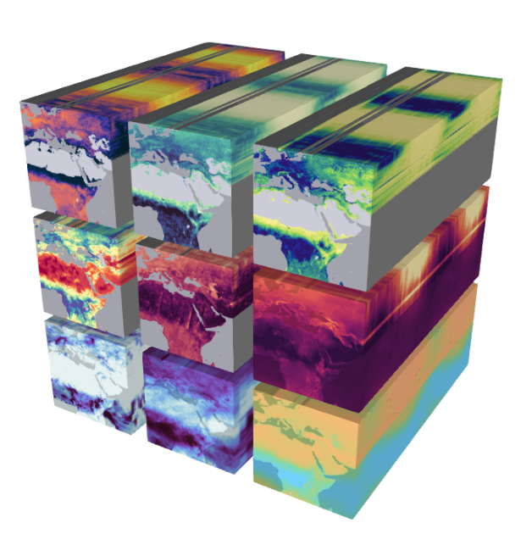
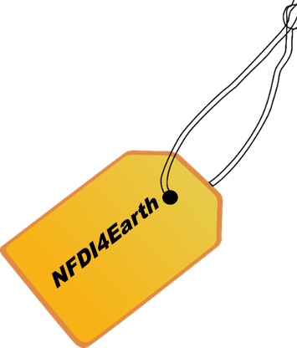
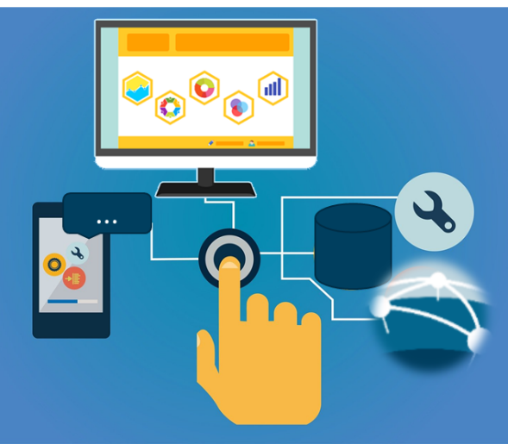
Key Goals
One Community approach to sustainable, Open and FAIR
Research Data Management in Earth System Sciences (ESS)
Community driven agile development of innovative platforms
for data integration and collaborative data analysis
Qualification for people, data, tools and services
as a basis for FAIR RDM and viability
OneStop4All and User Support Network for ESS RDM
as integral part of NFDI and International Infrastructures
Key-driver of the build-up and operation of the NFDI
Notes:
…with NFDI4Earth as knowledge hub for spatio-temporal data

Slide 7
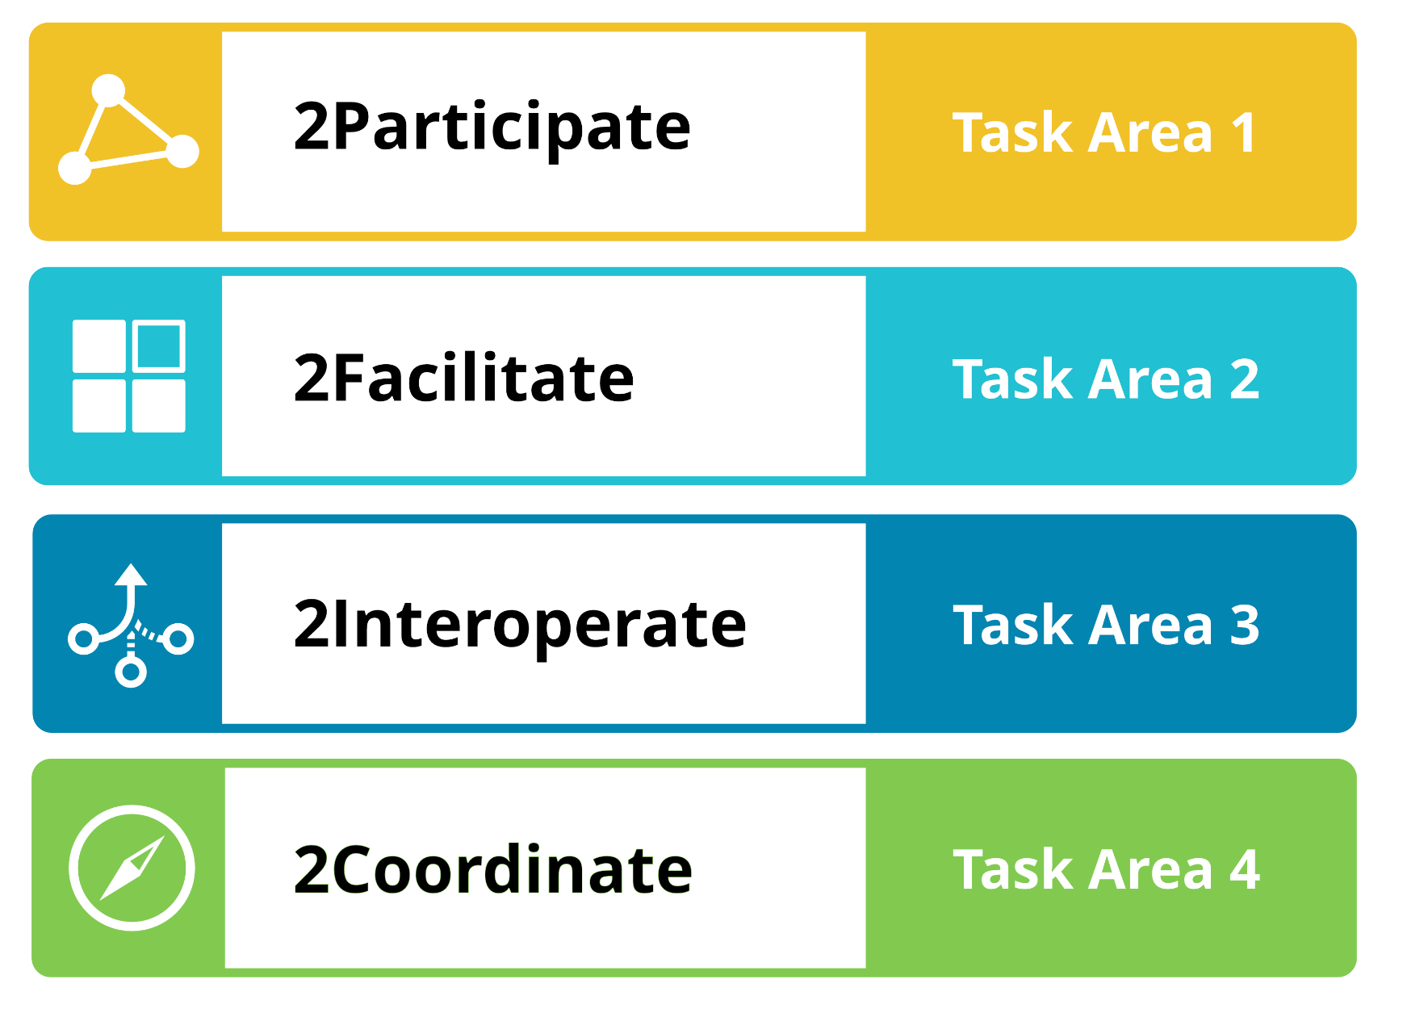
NFDI4Earth – Strategy 2021-26
Community Engagement
Piloting Innovations
User Perspective
Infrastructure Perspective
NFDI & International Integration
Community Support
Notes:
highlighten

Slide 8
Viability and Vision
NFDI4Earth FAIRness and Openness Commitment
  Engage all ESS stakeholders (researchers, societies, infrastructures, publishers,…)
  Foster incentives for Open and FAIR RDM in ESS and trigger cultural change
Proceed as one national ESS Community Effort
  Link into and benefit from related initiatives
  (e.g. Helmholtz Research Field Earth and Environment DataHub, GDI-DE,…)
  Become integral part of NFDI, EOSC and international infrastructures
Develop a common long term operation model
for NFDI4Earth services building on partners’ contributions
Provide an inspiring and vibrant environment for
novel Earth System Data Science approaches
!

